Slide 1
The ABC’s of Science Writing
Memoirs of an Ignorant Journalist
Otto Ross

Slide 2
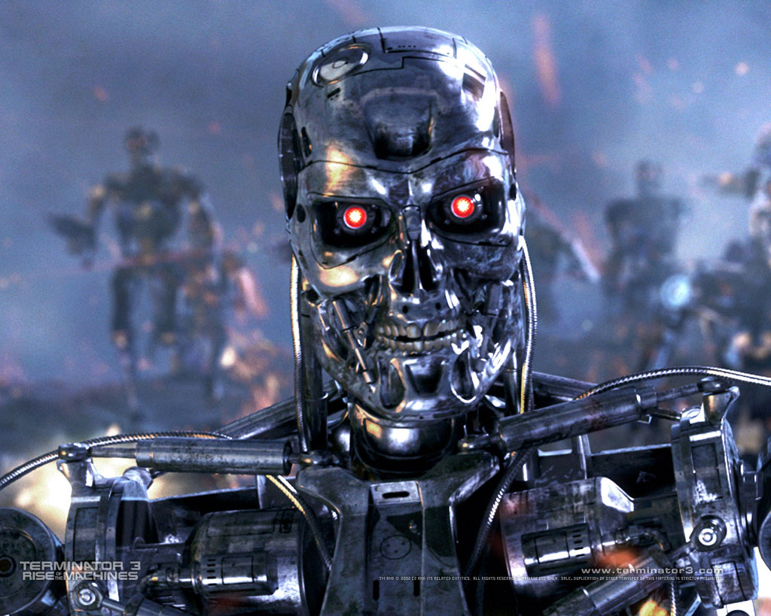

Slide 3
(Minutes)
(Level of Understanding)

Slide 5
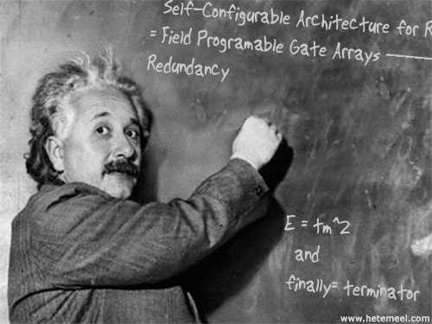

Slide 6
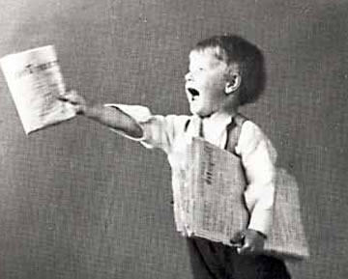
1) Send Press Releases

Slide 7
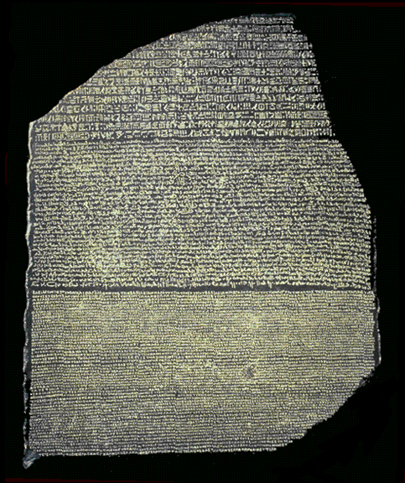
2) Use Plain Language

Slide 8
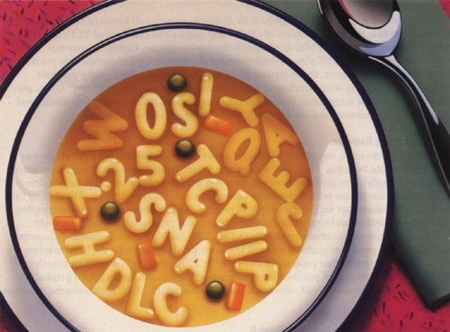
3) Never Use Acronyms

Slide 9
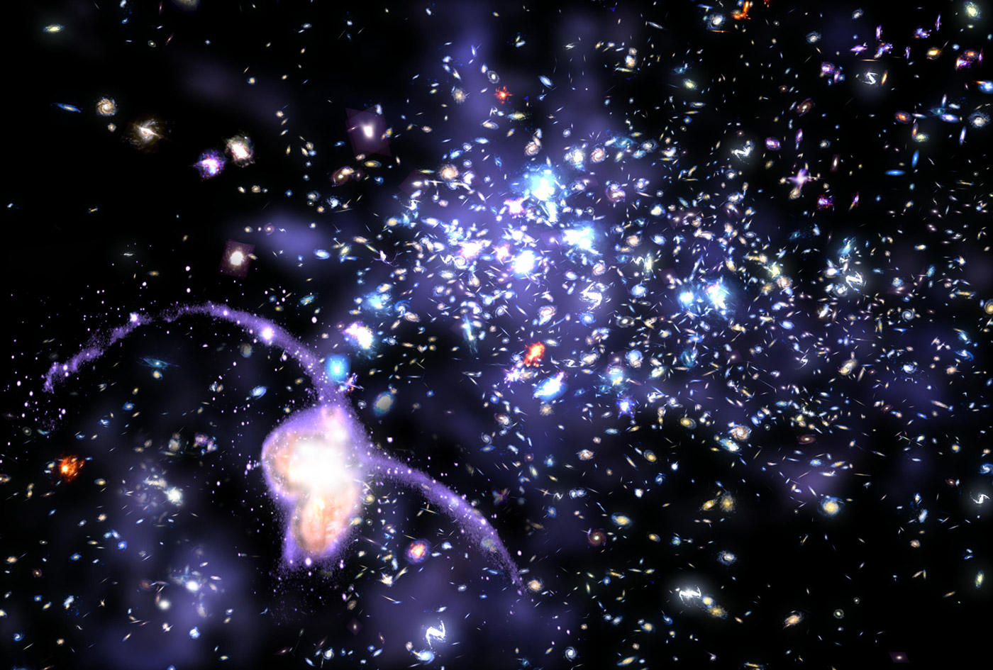
4) Suggest Art

Slide 10

5) Give Background

Slide 11
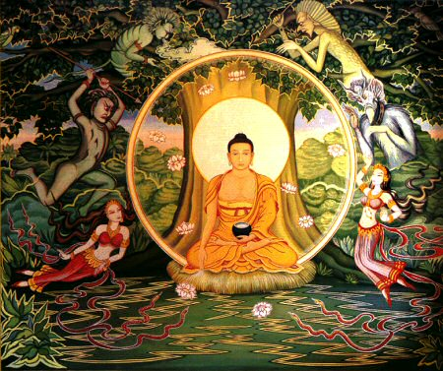
6) Be Patient

Slide 12
Thank You!

